Slide 1
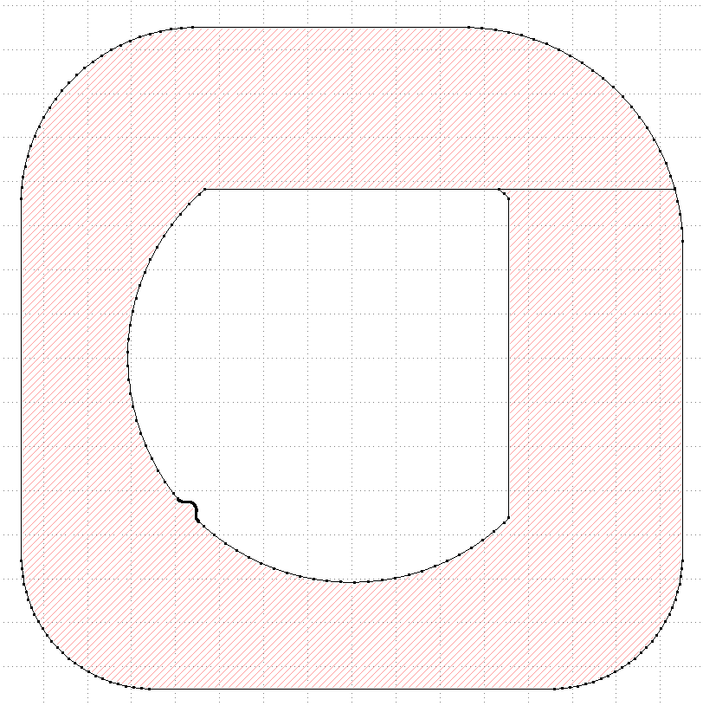
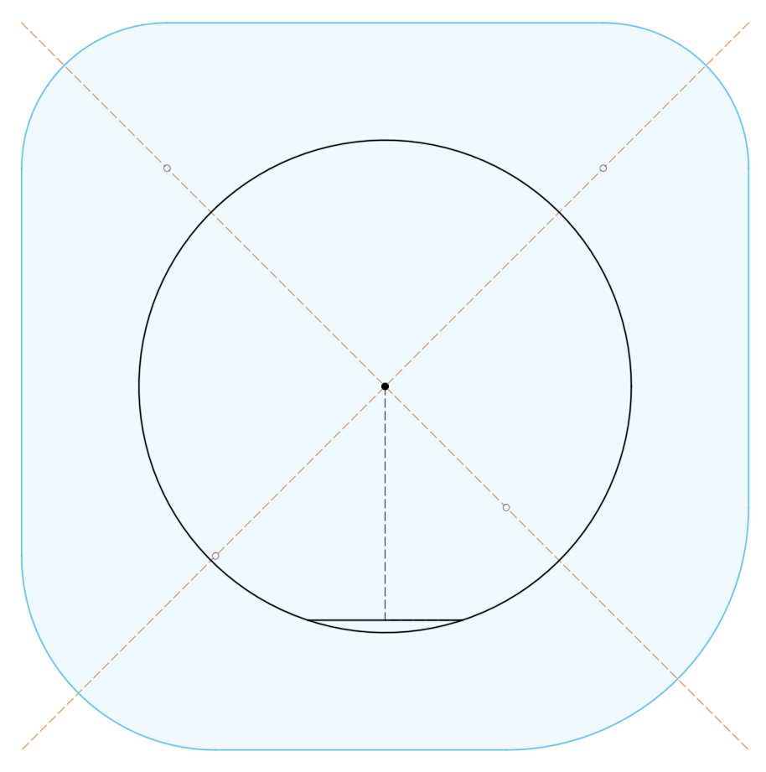
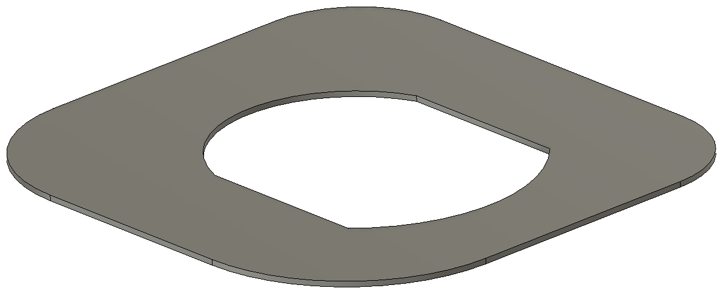

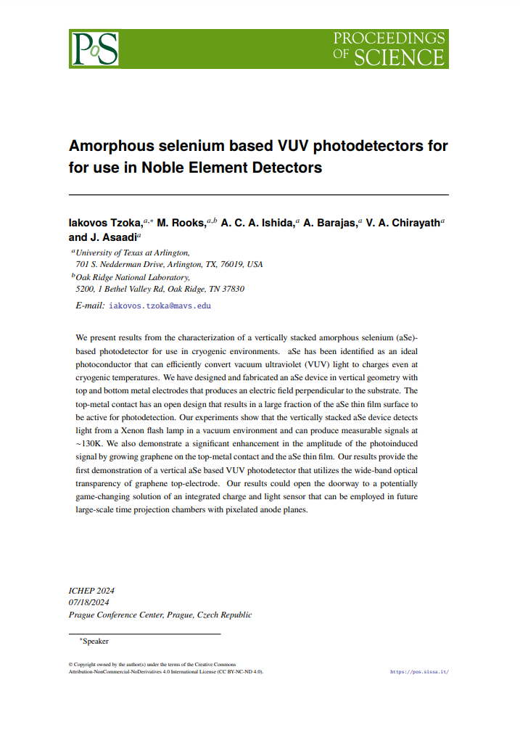
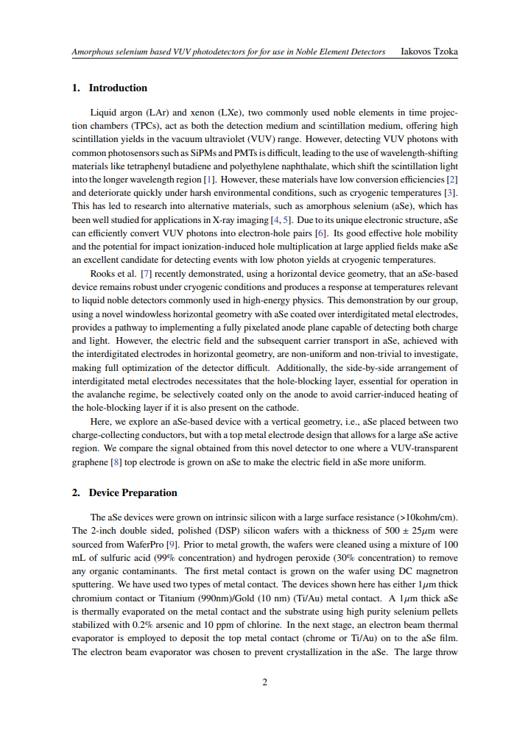
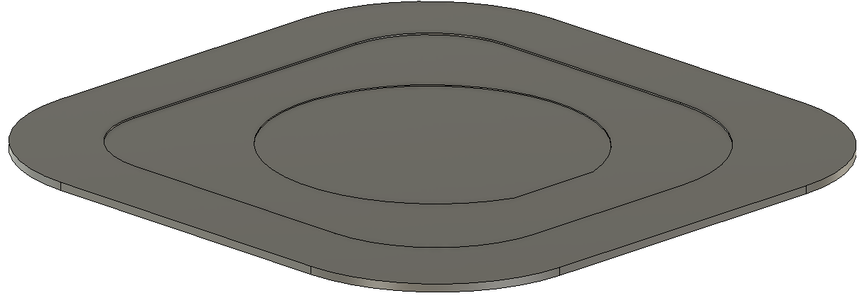
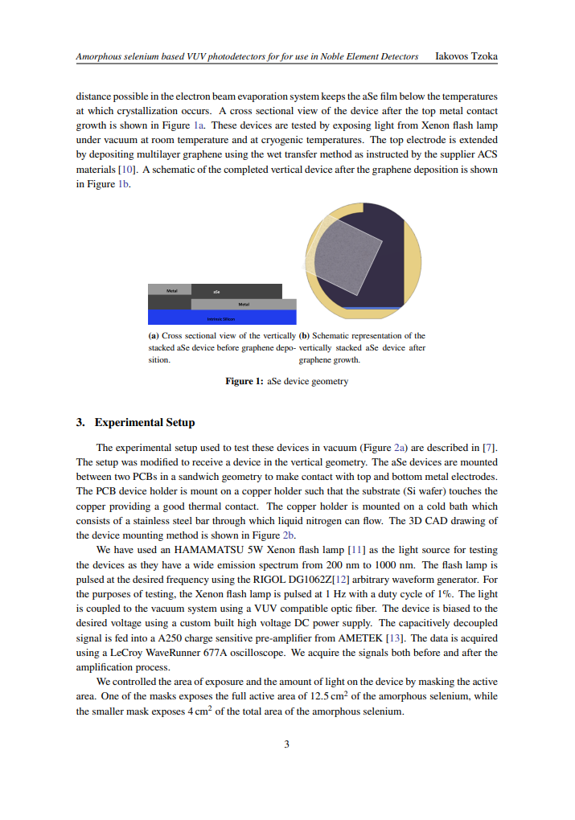
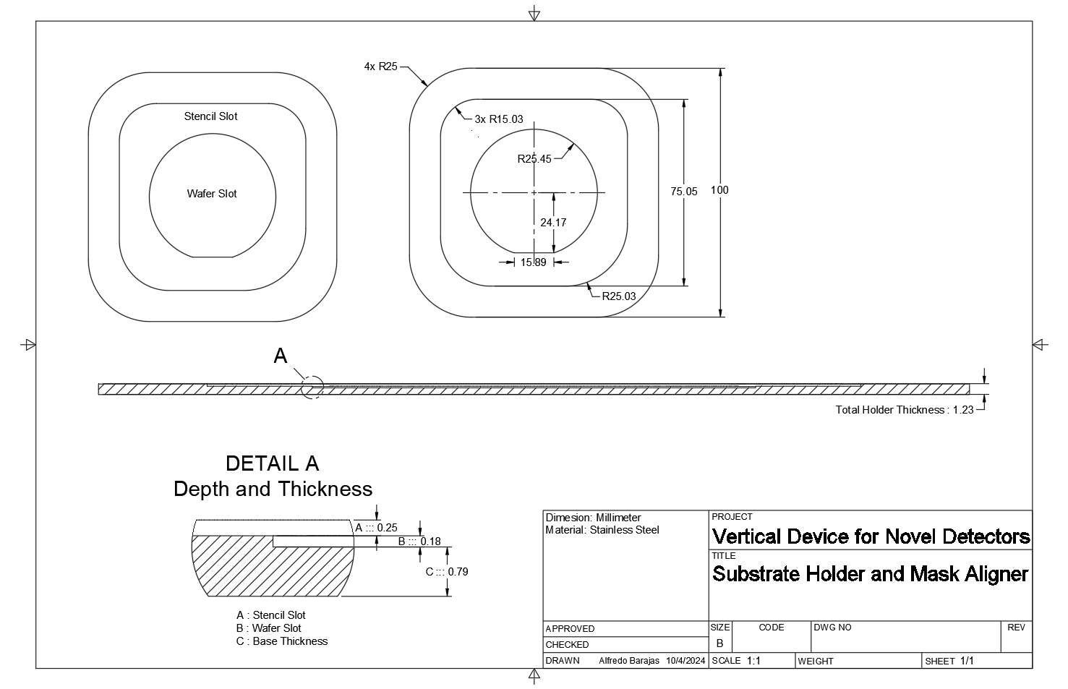
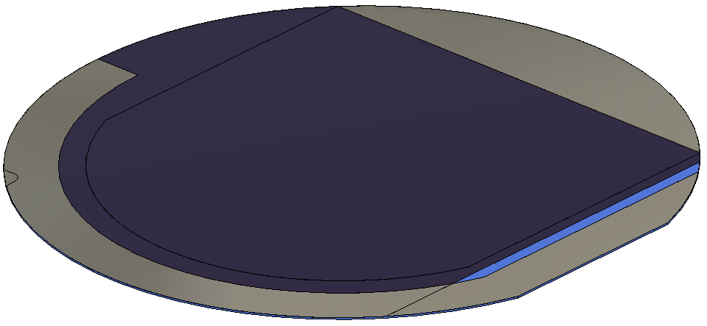
Files Available
3D CAD [ .step ]
2D CAD [ .dxf ]
Academic Paper [ .pdf ]
./Models/Masks/Name.step
./DXF/Name.dxf
./Academic Paper/Amorph…
4x Shadow Masks
./Models/Masks Aligner/Mask Aligner.step
Drawings [ .pdf ]
./DXF/Name.dxf
Mask Aligner
./Models/Wafer Model/Wafer Model.step
Wafer Model

Slide 2
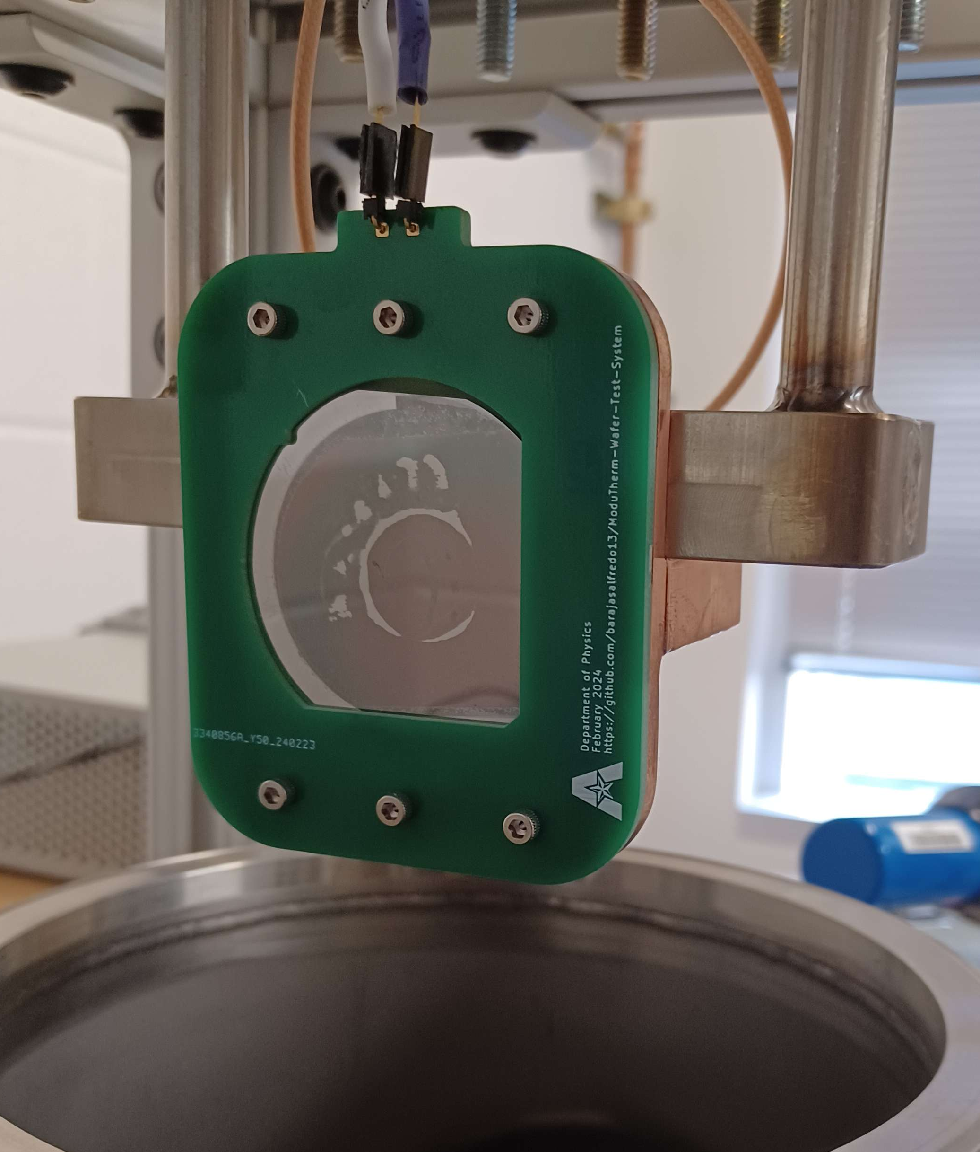
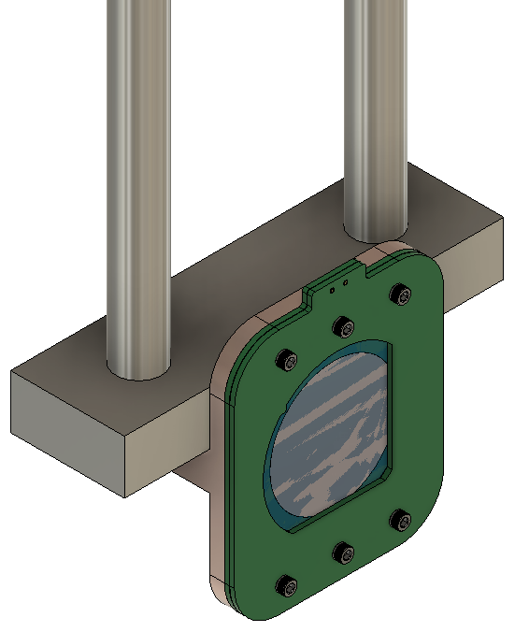
Temperature Testing Stand for 2-inch Silicon Wafers used in Experimental Research in VUV Photodetectors

Slide 3
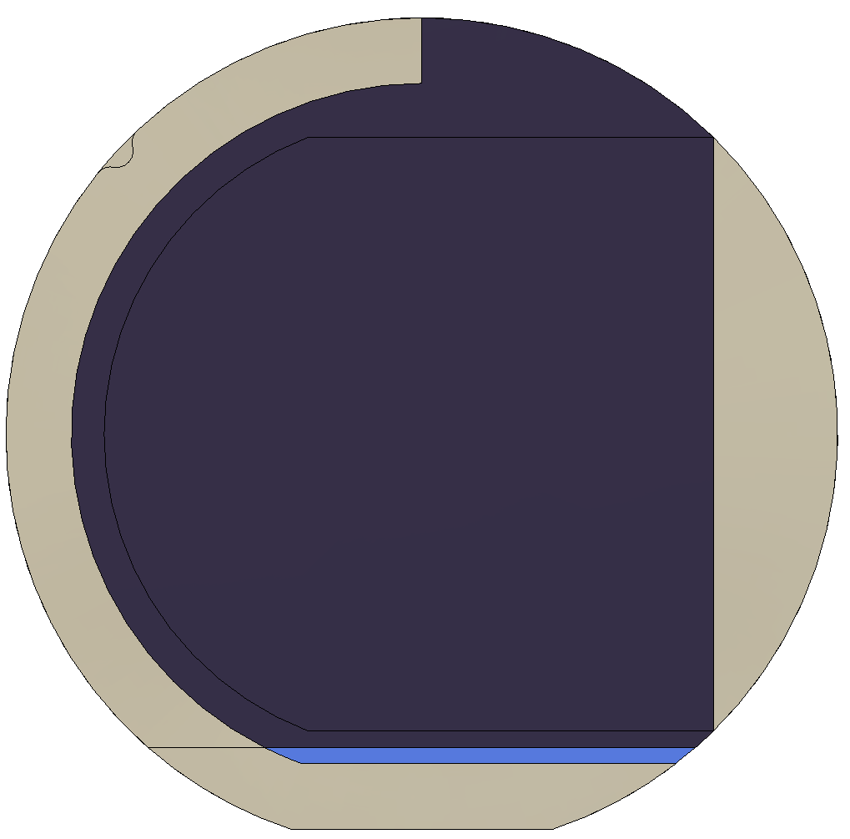
Designs used for Amorphous Selenium shadow masks in experimental work for VUV photodectectors

Slide 4
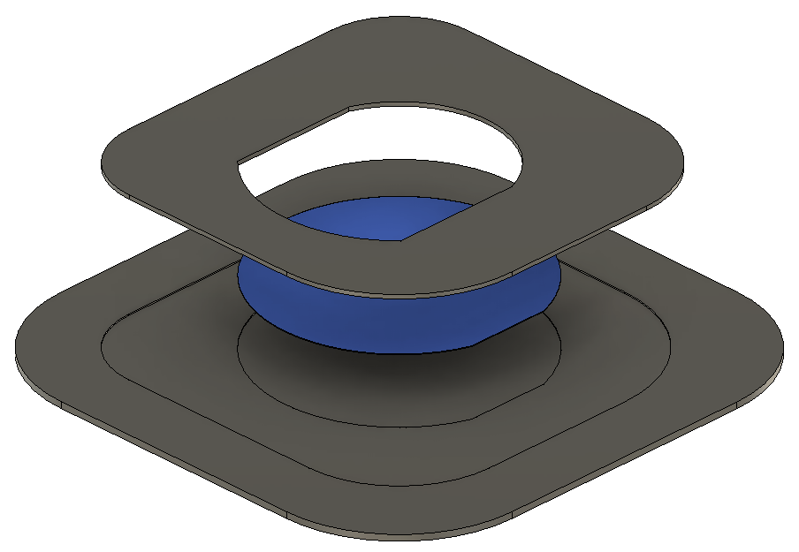
Mask and Holder
Mask
Silica Wafer
Mask Holder

Slide 5
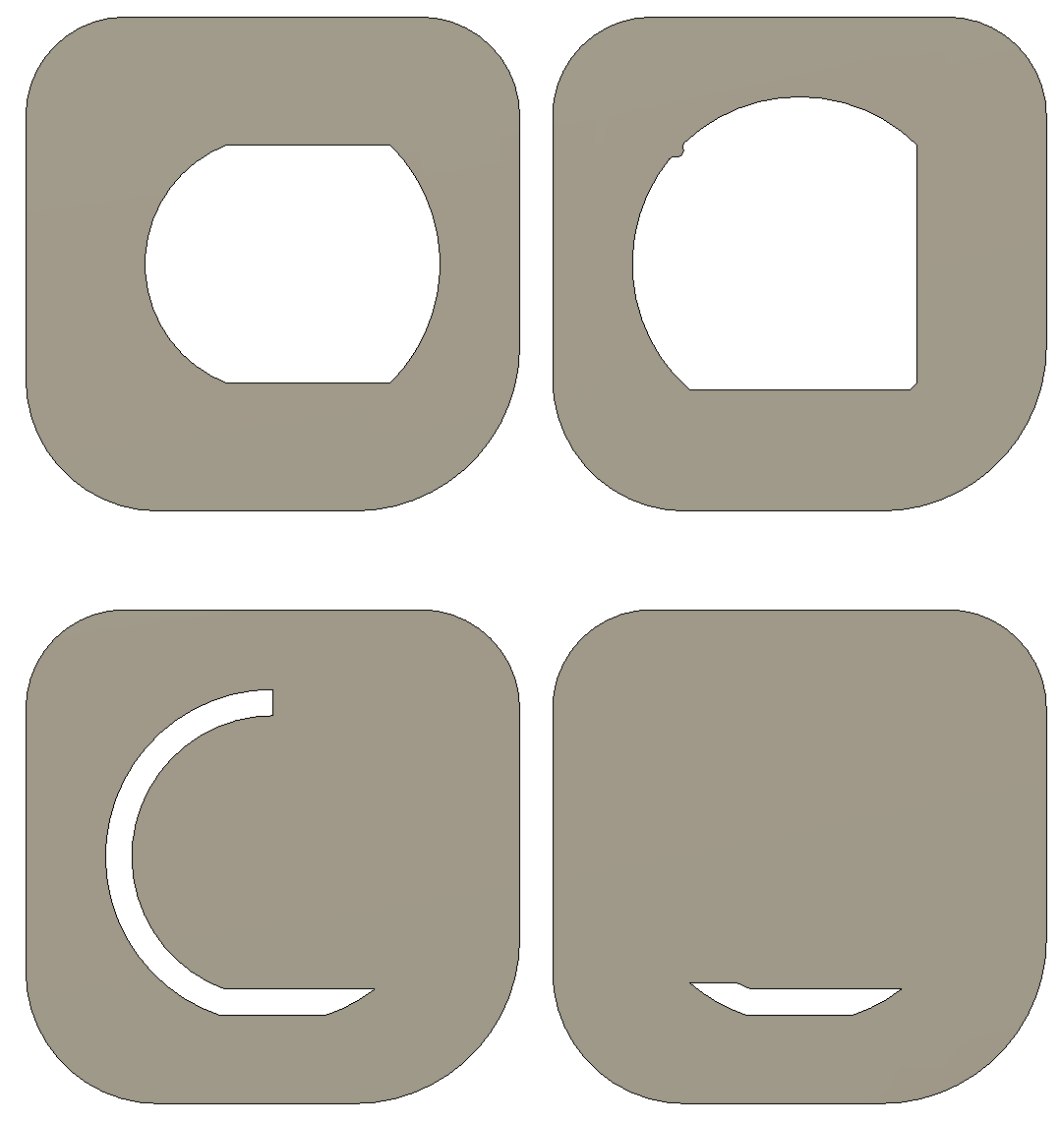

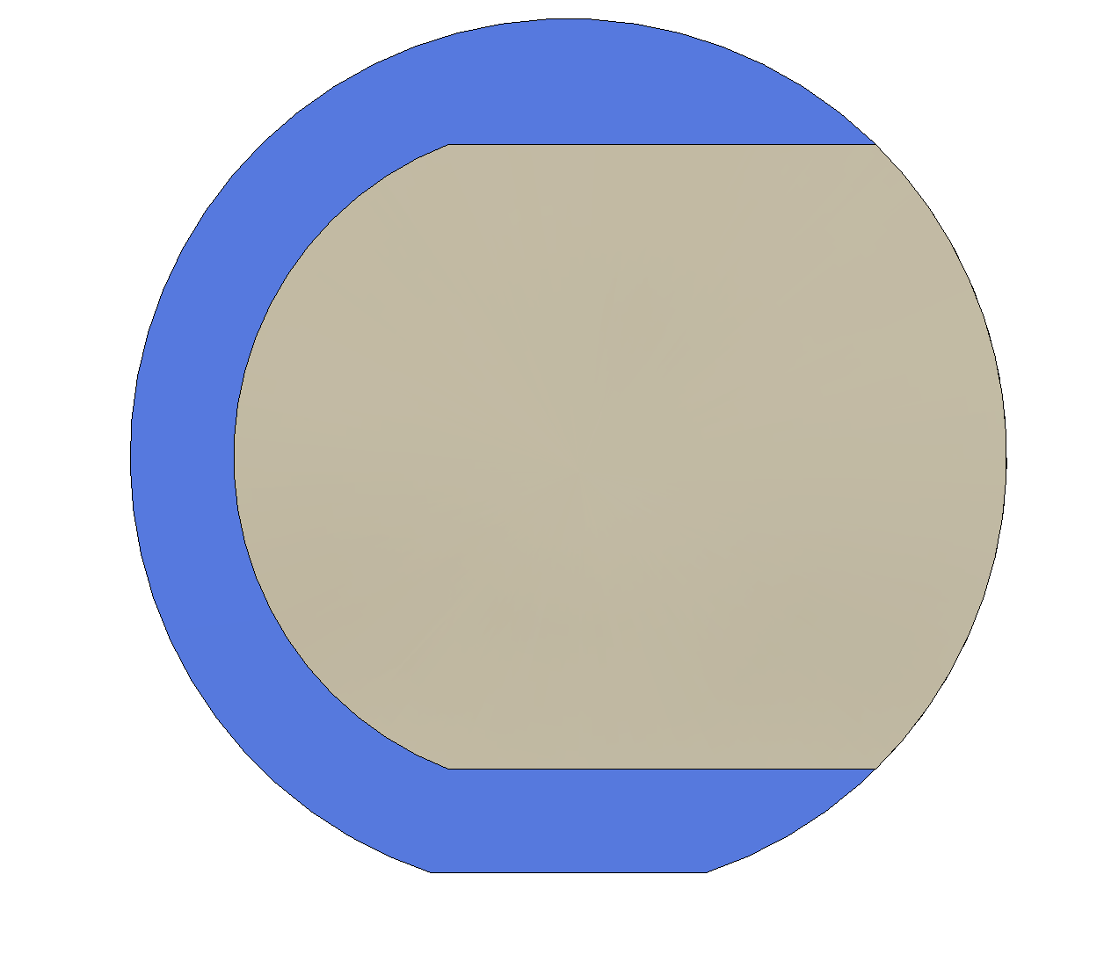
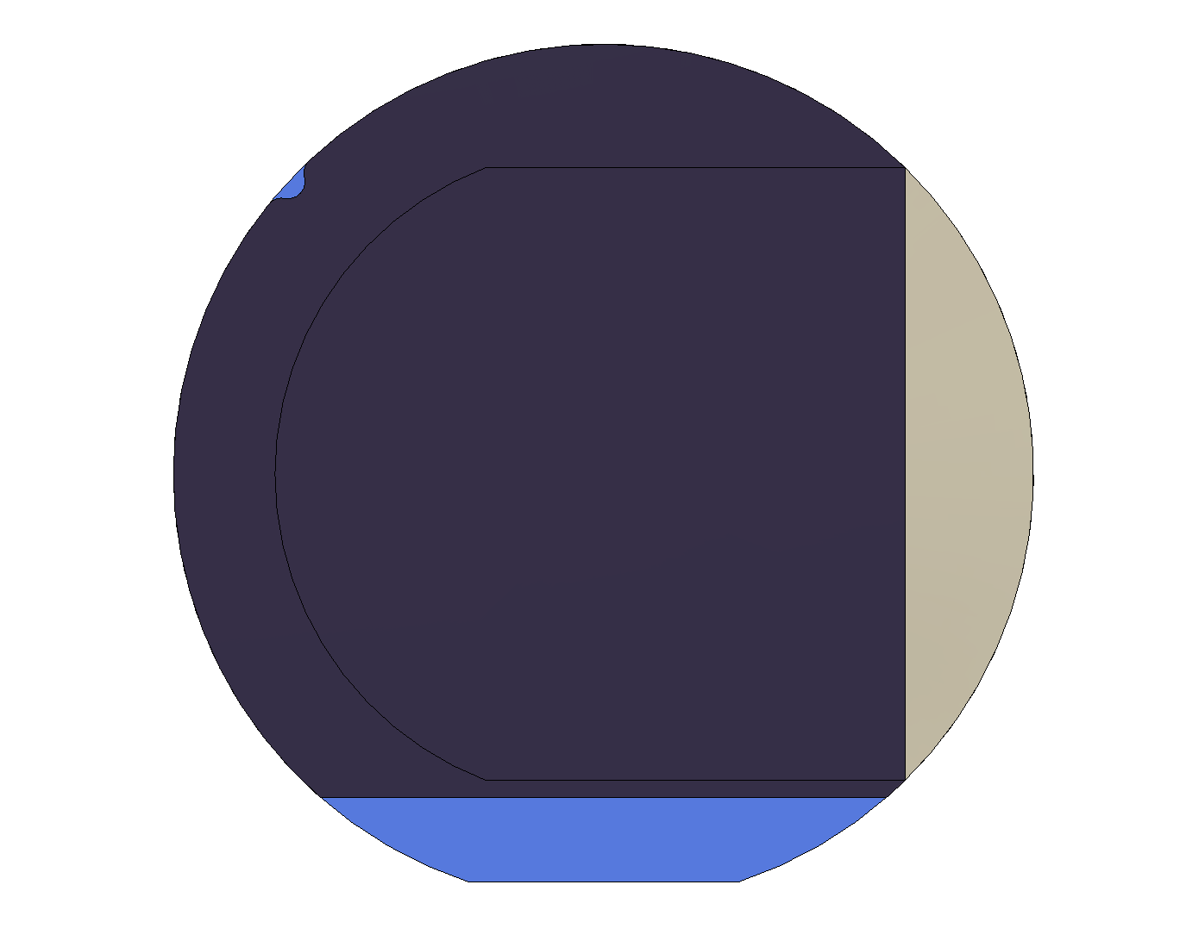
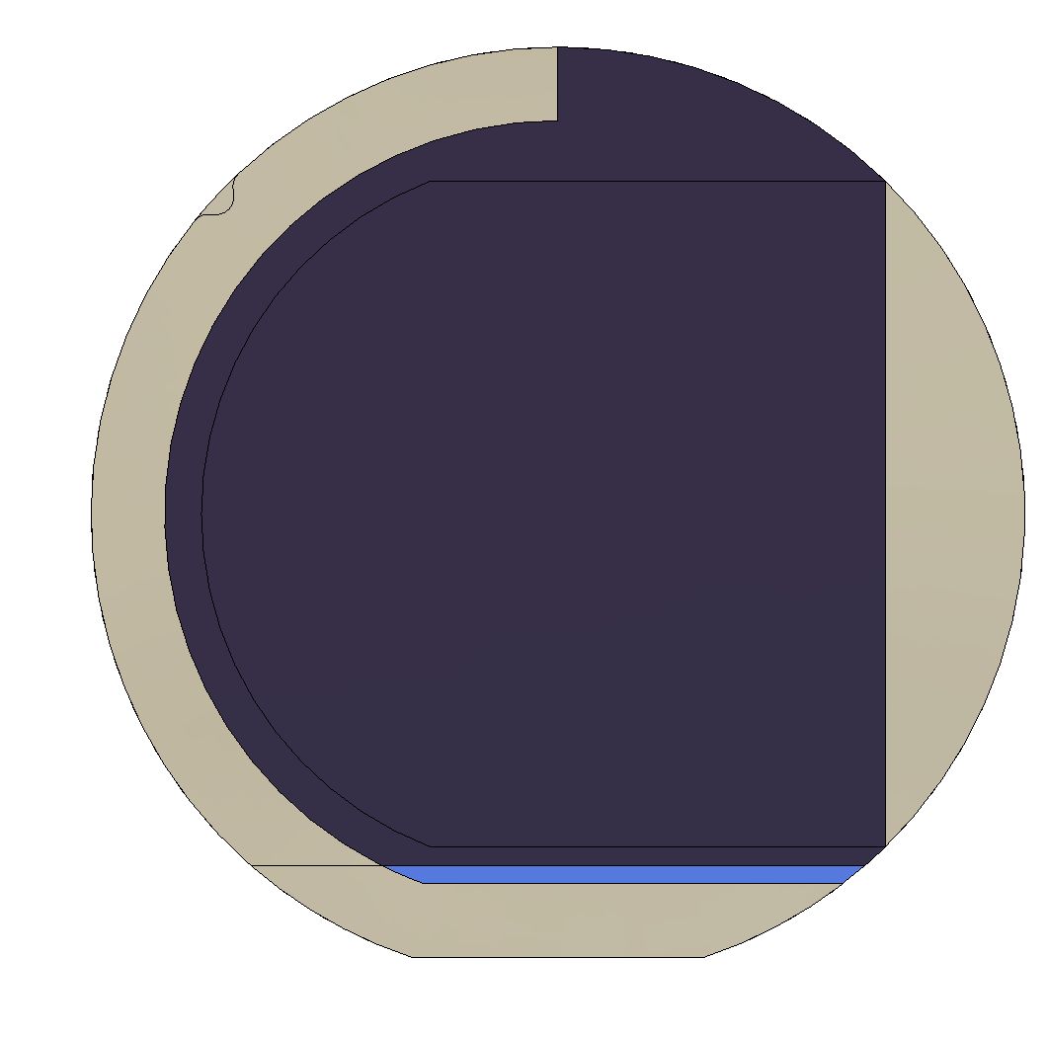
Base Conductor Mask
Base Conductor Mask
Test Material
Test Material Mask

Slide 6
Top Conductor 1
Top Conductor 1 Mask
Top Conductor 2
Top Conductor 2 Mask

Slide 7
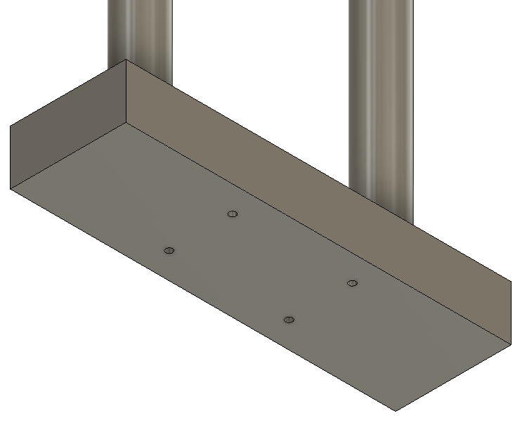
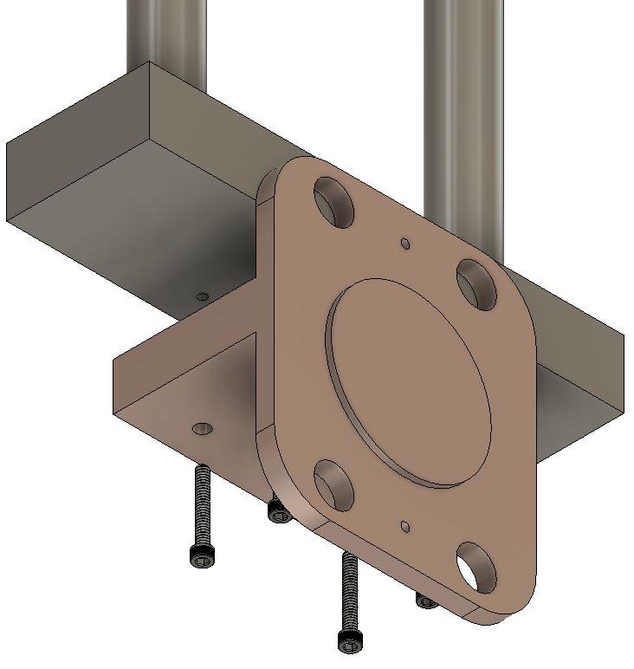
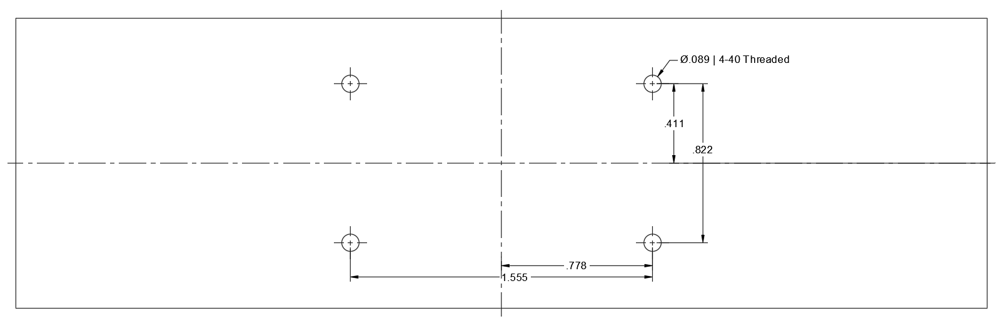
Mounting the Copper Temperature Block
Hole Dimensions and Locations of Stainless-Steel Block

Slide 8
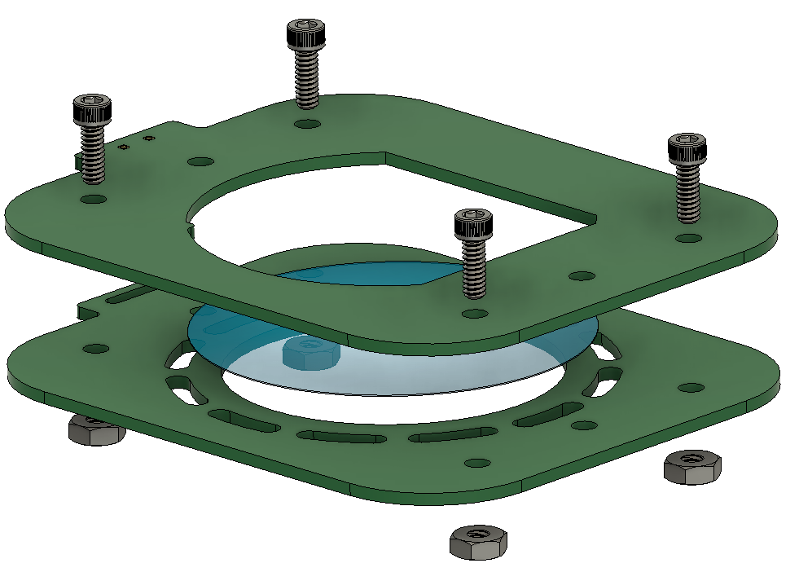
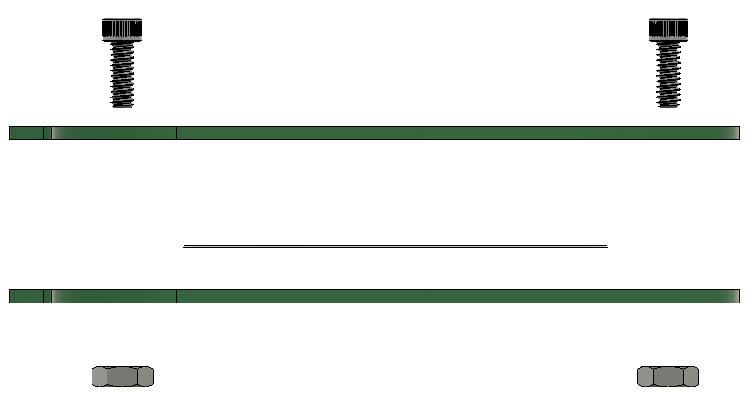
Mounting Samples onto the PCB Card
A
B
C
D
E
A – Vented Socket Head Screw B – Top Probe Card C – 2 Inch Substrate
D – Bottom Probe Card
E – Mil. Spec. 18-8 SS Hex Nut

Slide 9
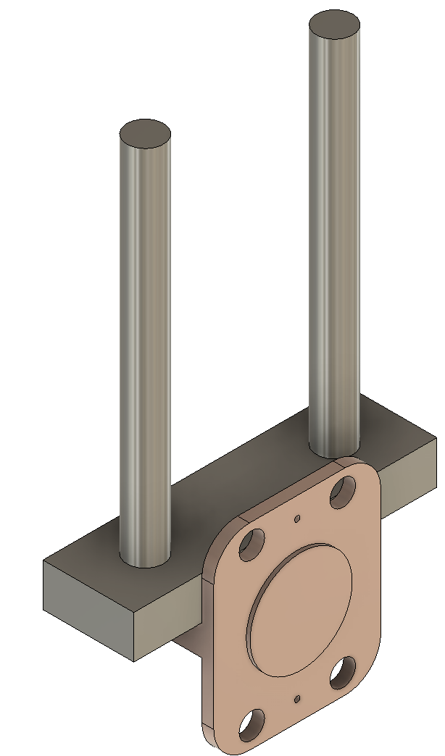
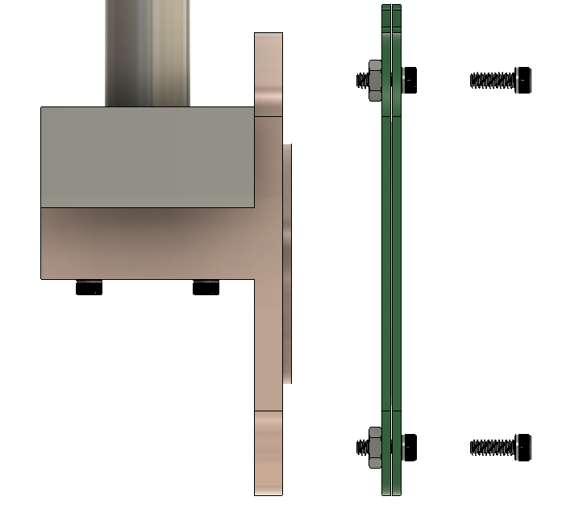
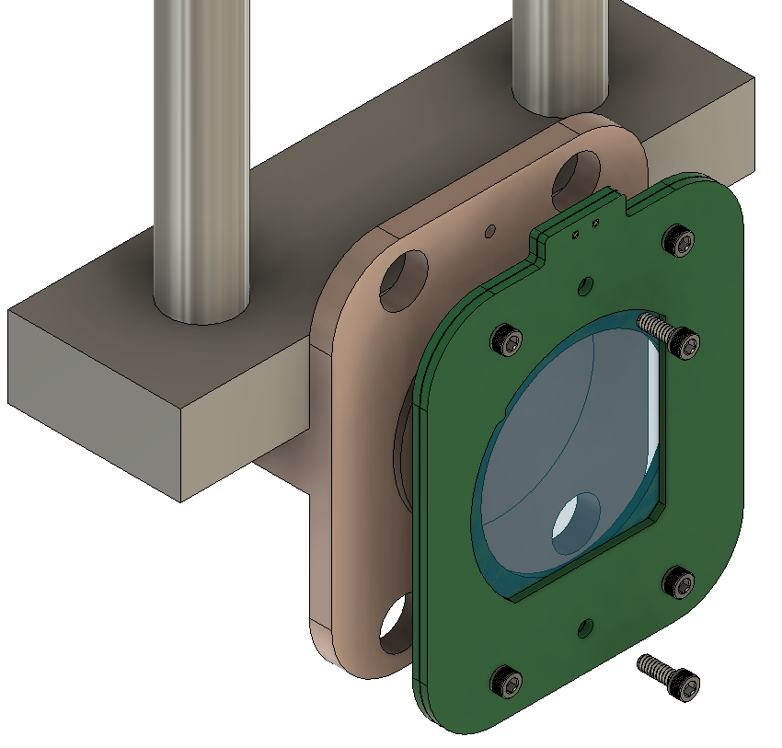
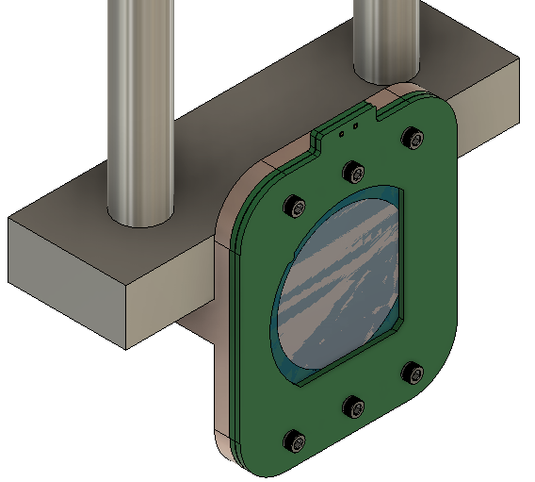
Mounting the Copper Temperature Block
B
A – Temperature Node B – Vented Socket Head Screw C – PCB Card
A
C

Slide 10
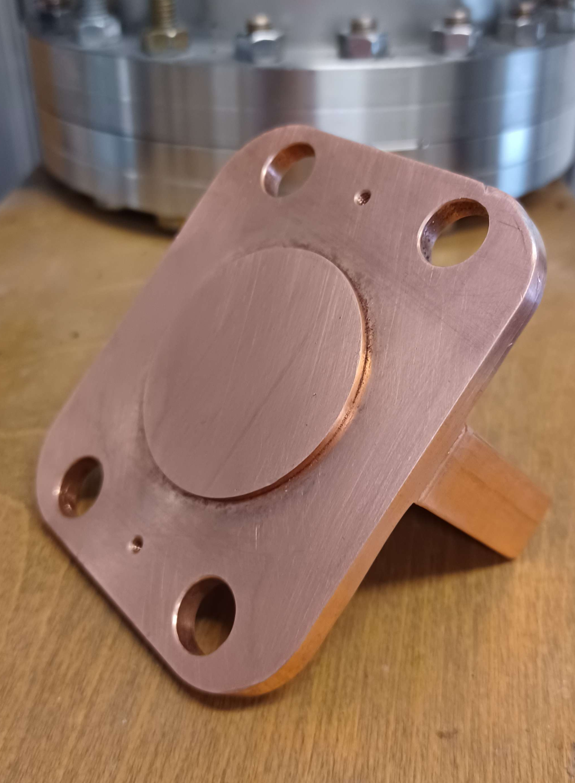
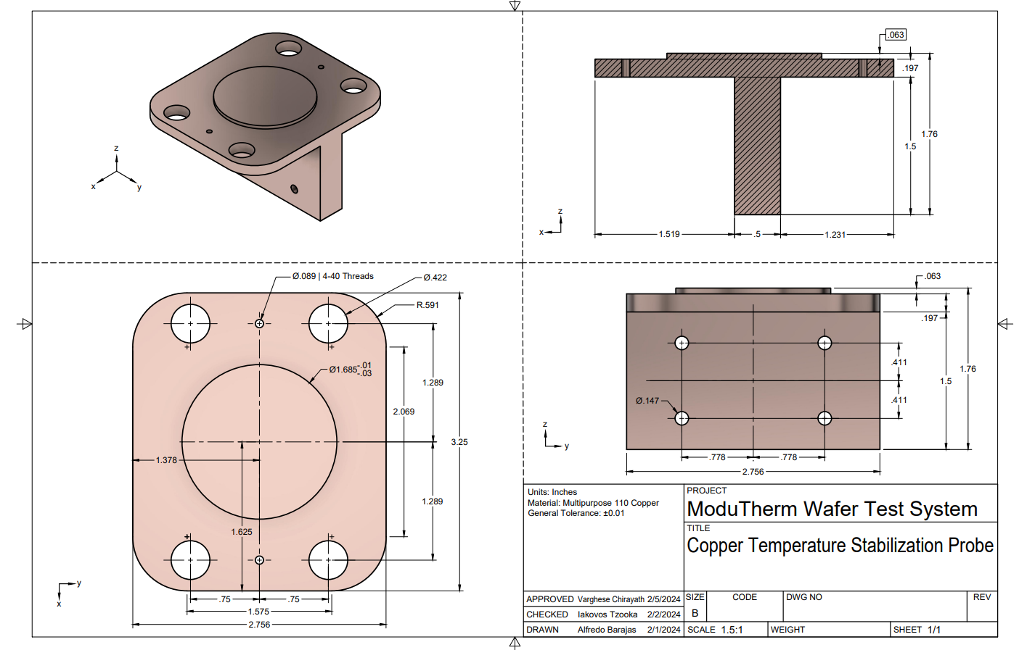
Copper Temperature Node
Drawings are included for reproducibility of the system

Slide 11
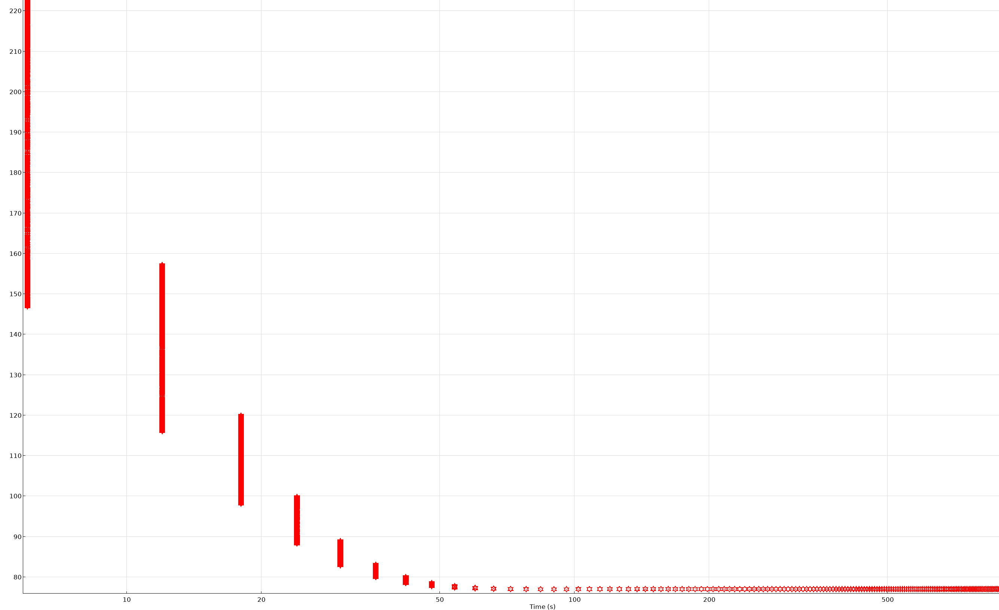
Boundary Analysis of Temperature for Copper Node
It is expected that after ~ 100 seconds under, liquid Nitrogen flow, that the Copper Node will converge onto 77 K

Slide 12
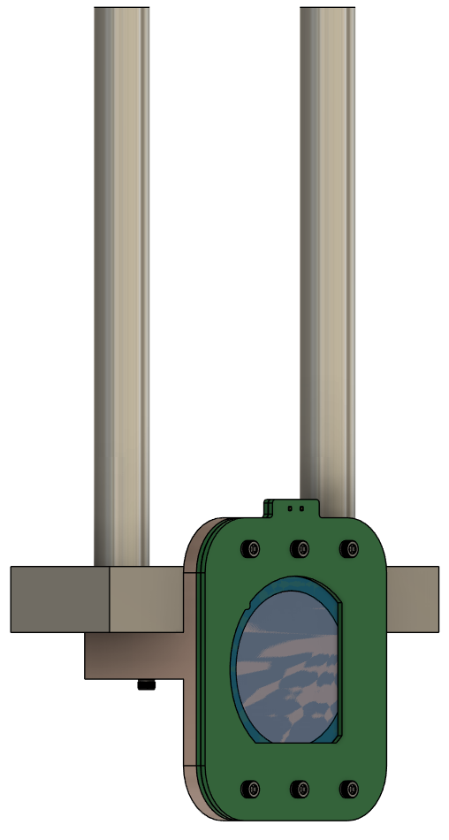
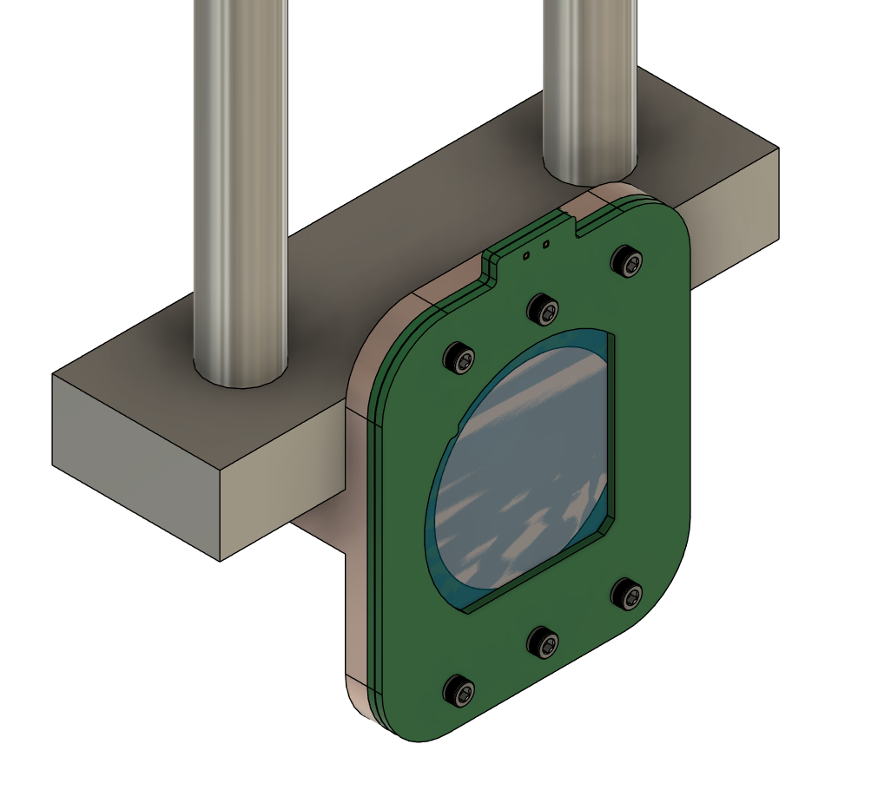
Demo Model
A render of the model is available in the repository under the /3.Demo folder

Slide 13
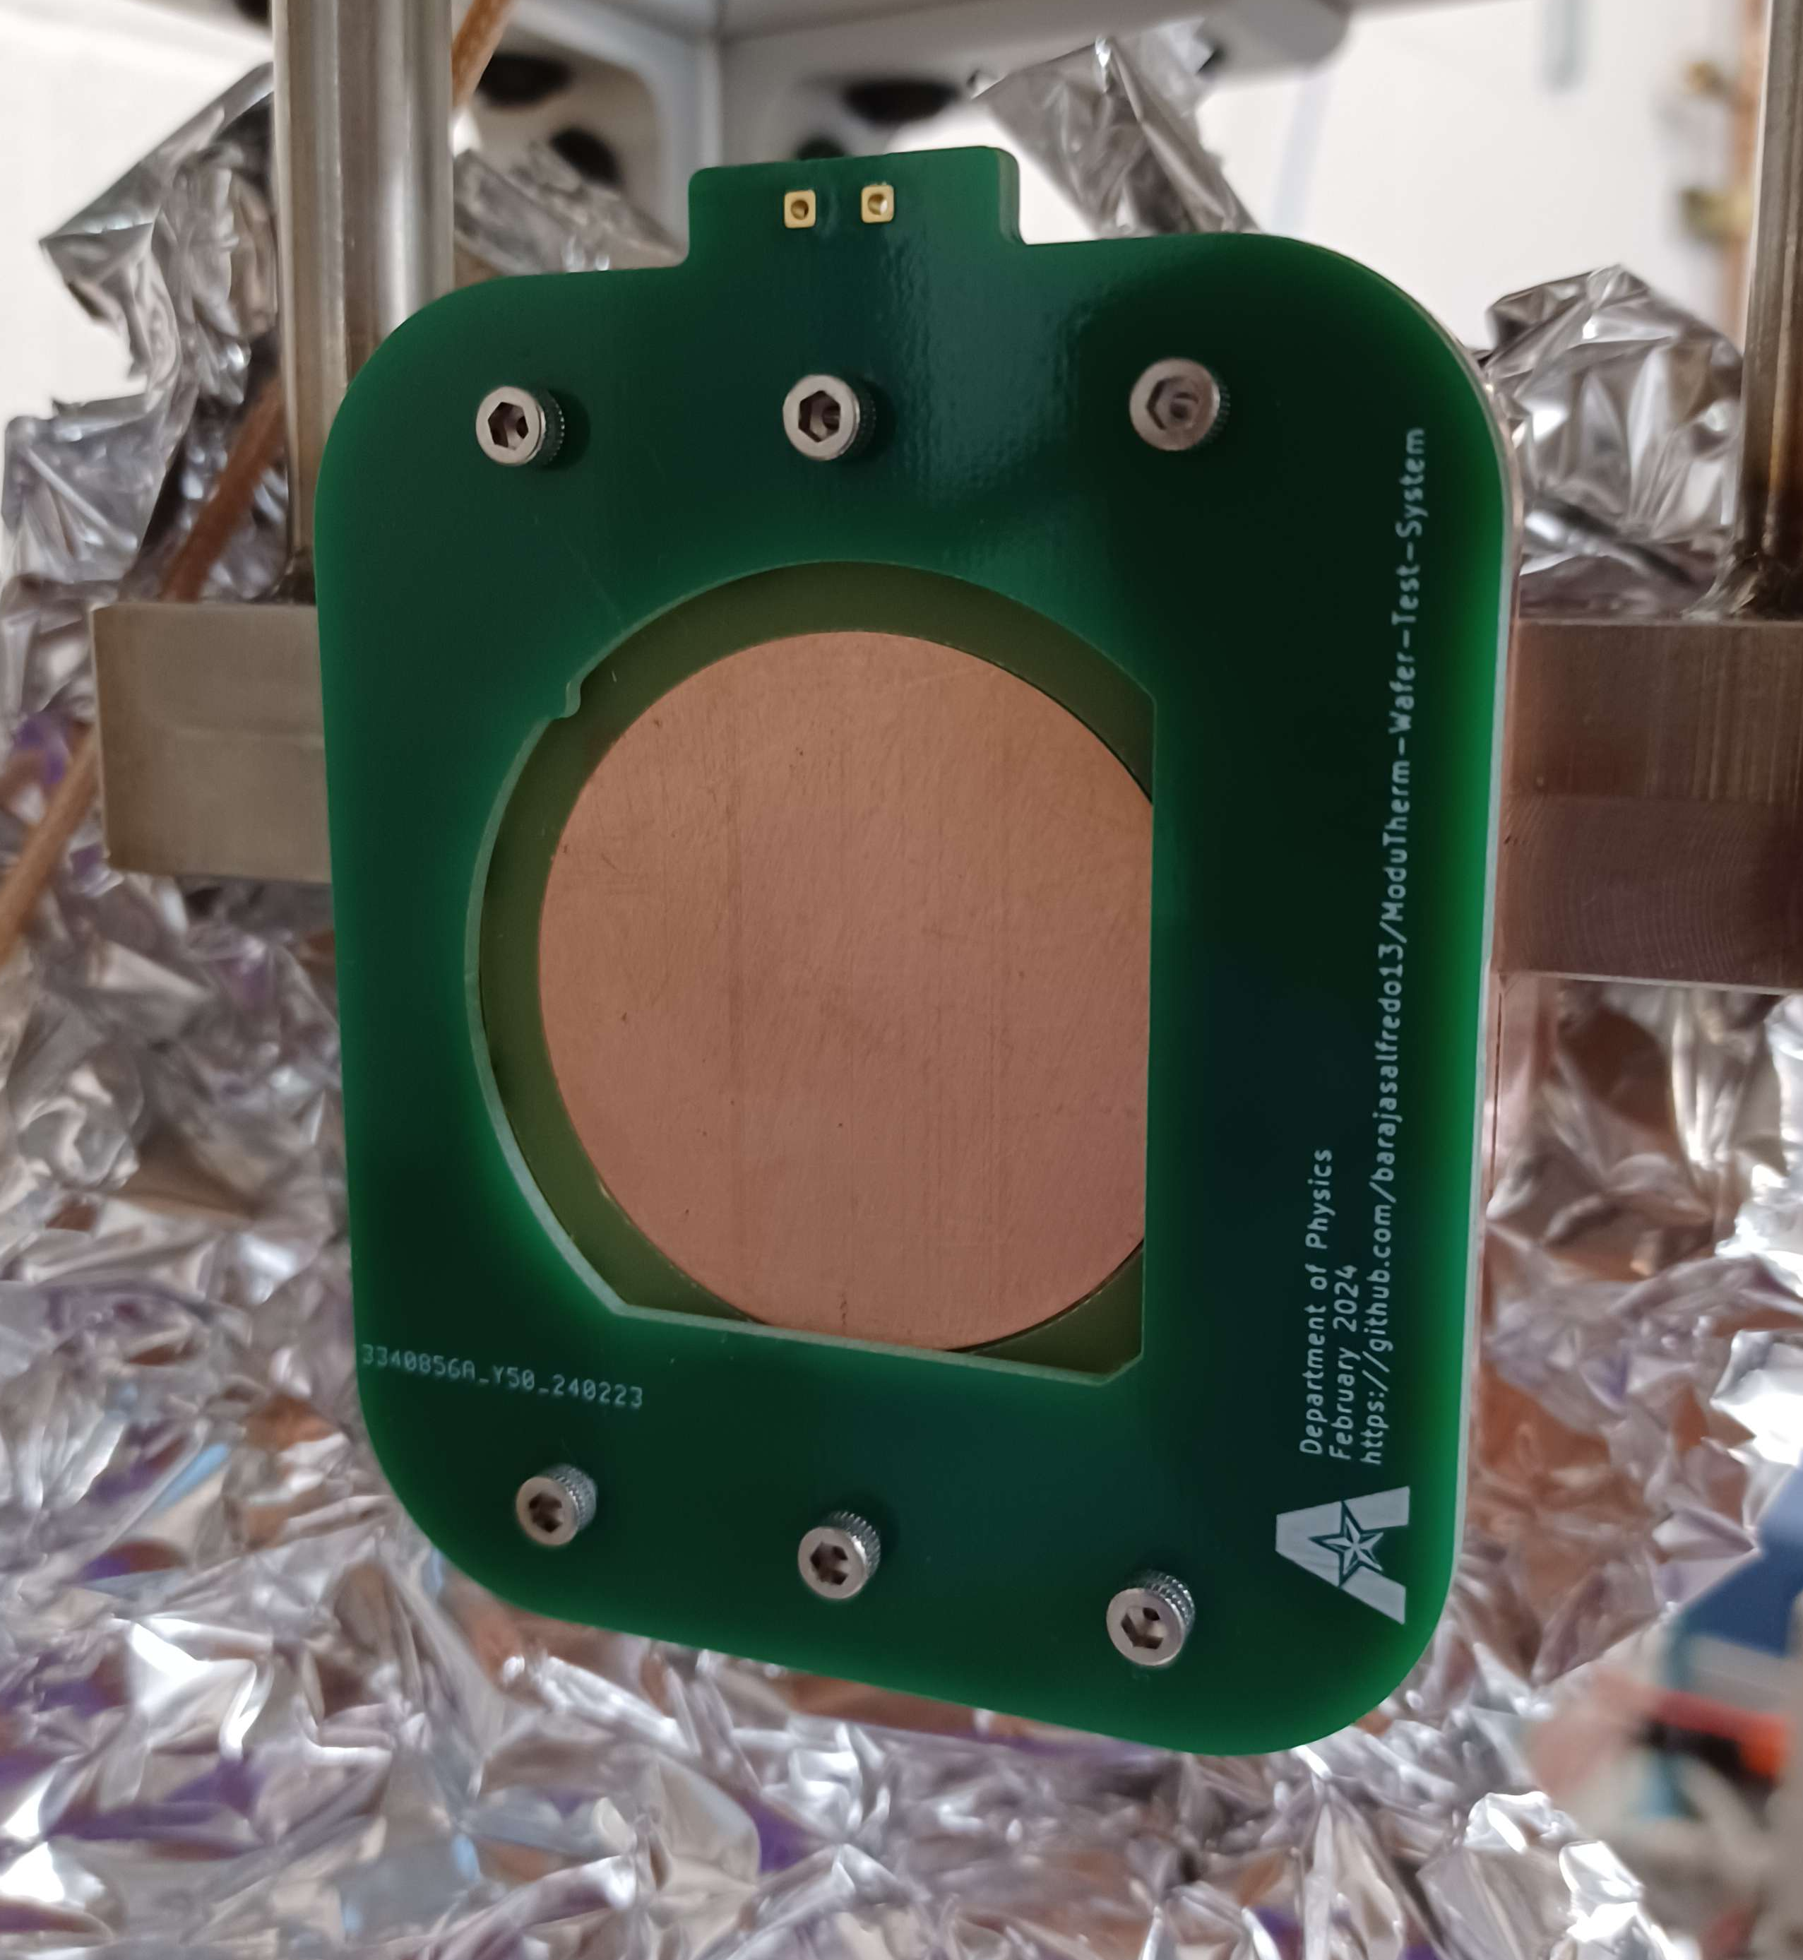
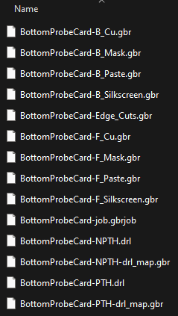
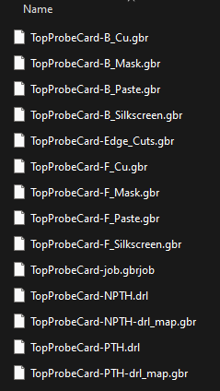
PCB Card
The Gerber Files generated are for the test of a vertical device, BUT the KiCAD Files contained have been made to accommodate modifications for new devices

Slide 14
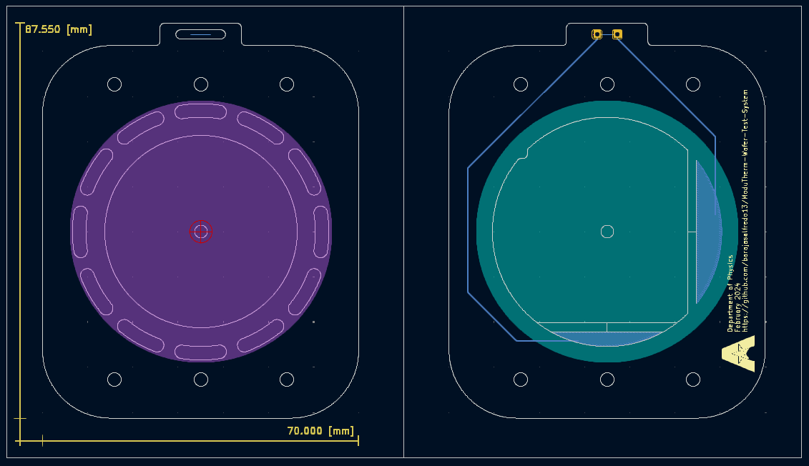
KiCAD Layer View

Slide 15
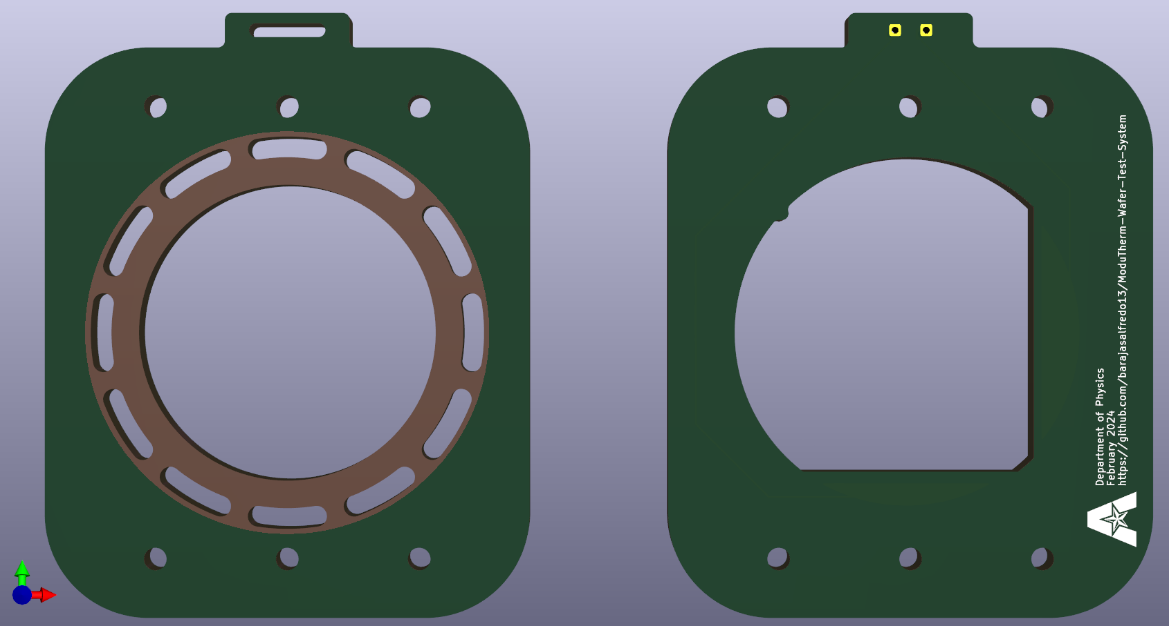
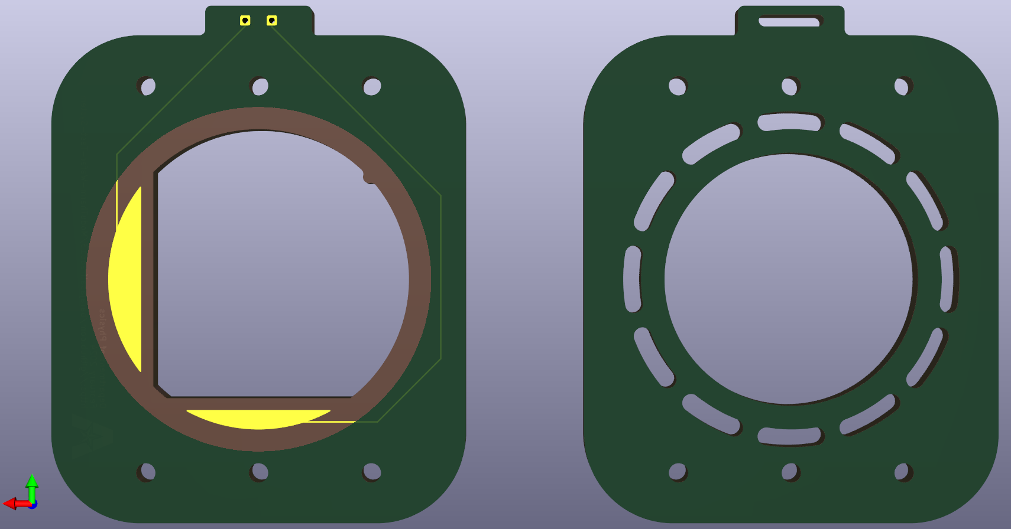
PCB Card Render

Slide 16

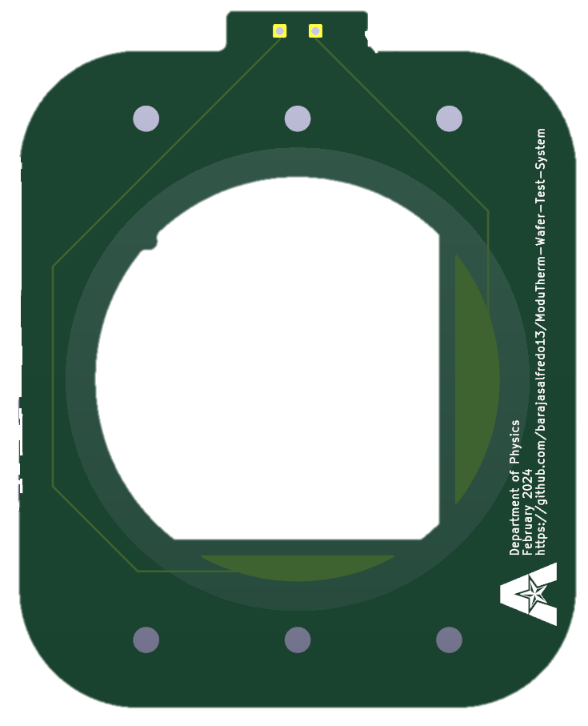
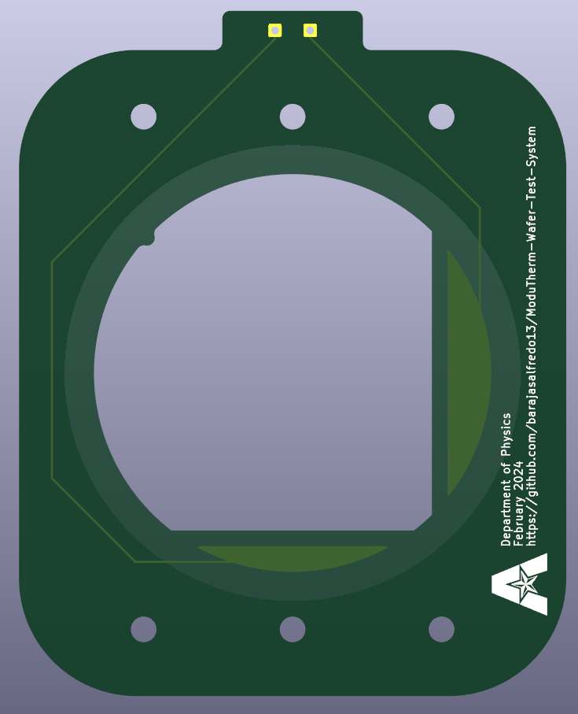
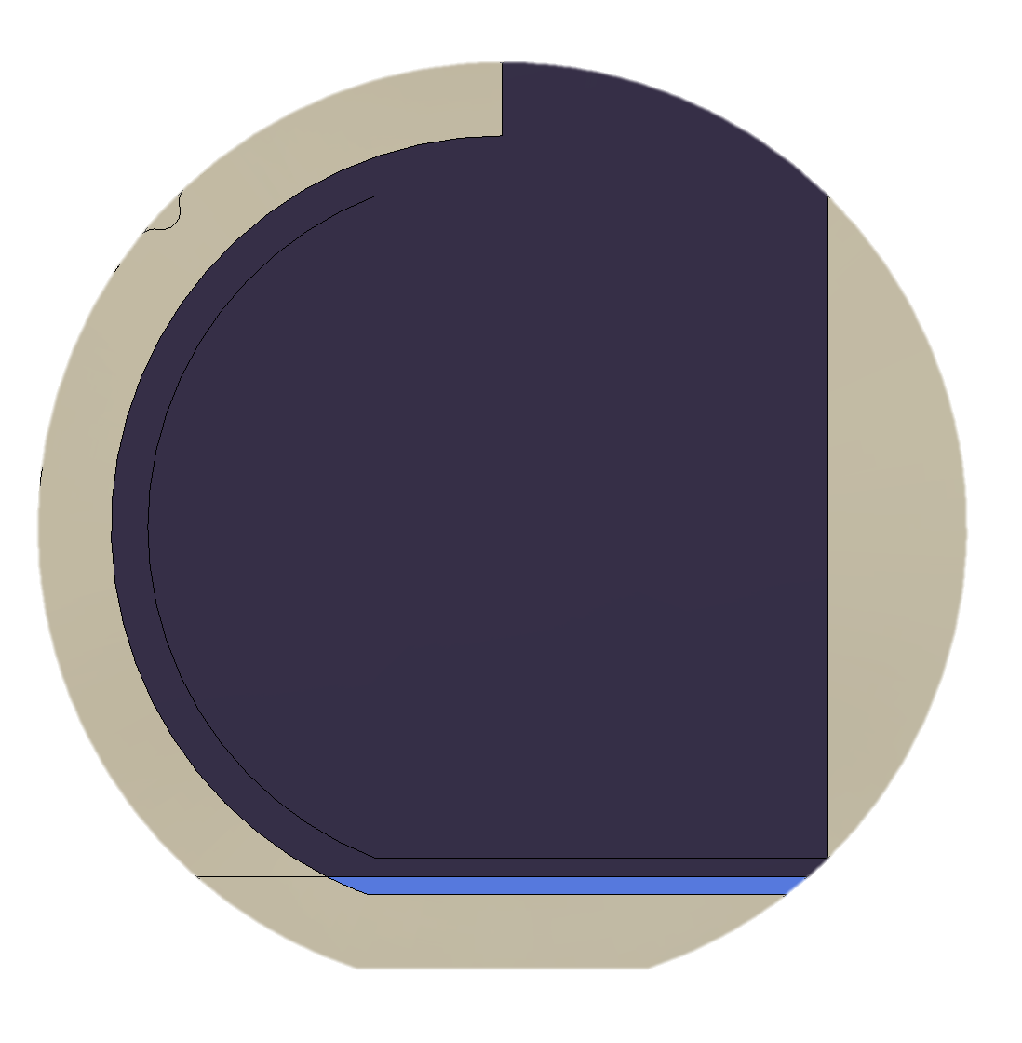
Sample Mount Render

